Slide 1



MERN – ES6 + React
Module 04: CSS Advanced

Slide 2
Outline
Module 04
learning about Fonts
learning about Box Model
learning about font properties with CSS
learning about size
learning about weight
learning about text alignment

Slide 3
CSS Text
CSS has a lot of properties for formatting text.
Text Color
The color property is used to set the color of the text. The color is specified by:
a color name - like "red"
a HEX value - like "#ff0000"
an RGB value - like "rgb(255,0,0)“
The default text color for a page is defined in the body selector.
Important: High contrast is very important for people with vision problems. So, always ensure that the contrast between the text color and the background color (or background image) is good!

Slide 4
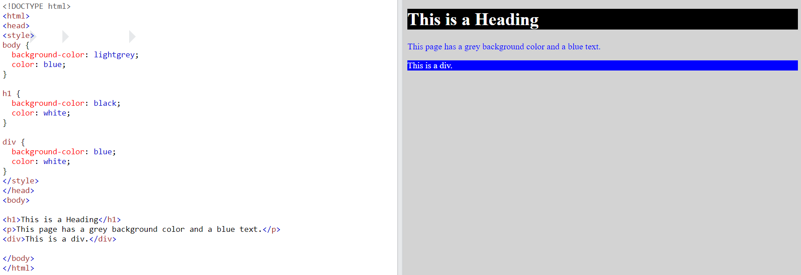
CSS Text
CSS has a lot of properties for formatting text.

Slide 5
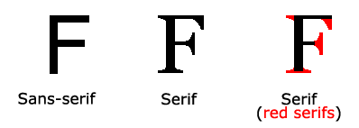
CSS Fonts
Choosing the right font has a huge impact on how the readers experience a website.
Generic Font Families
In CSS there are five generic font families:
Serif fonts have a small stroke at the edges of each letter. They create a sense of formality and elegance.
Sans-serif fonts have clean lines (no small strokes attached). They create a modern and minimalistic look.
Monospace fonts - here all the letters have the same fixed width. They create a mechanical look.
Cursive fonts imitate human handwriting.
Fantasy fonts are decorative/playful fonts.
Note: On computer screens, sans-serif fonts are considered easier to read than serif fonts.

Slide 6
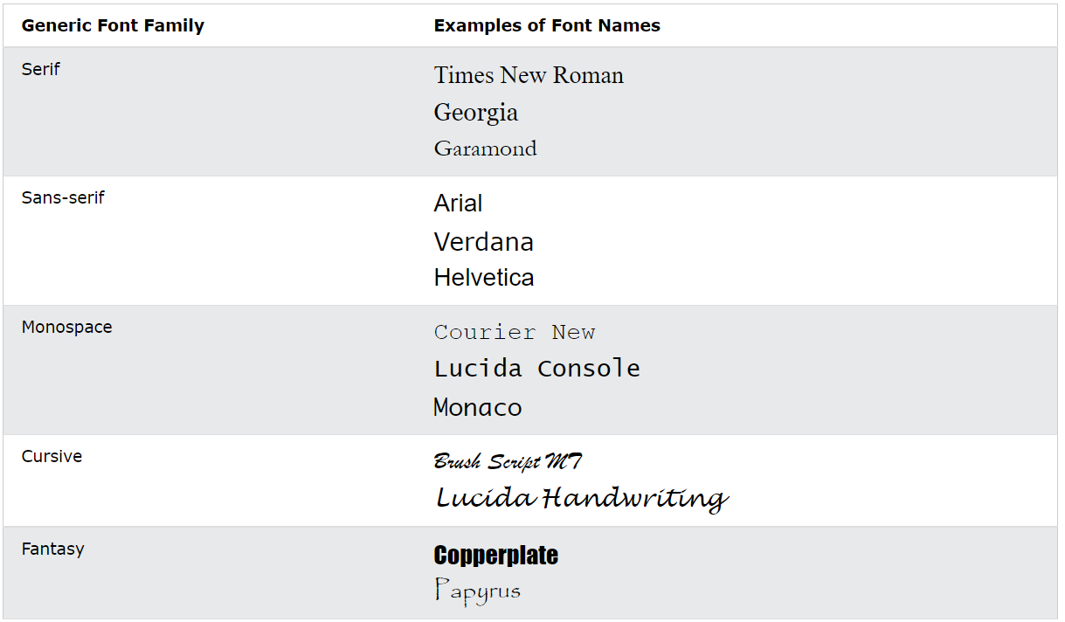
CSS Fonts
Choosing the right font has a huge impact on how the readers experience a website.

Slide 7
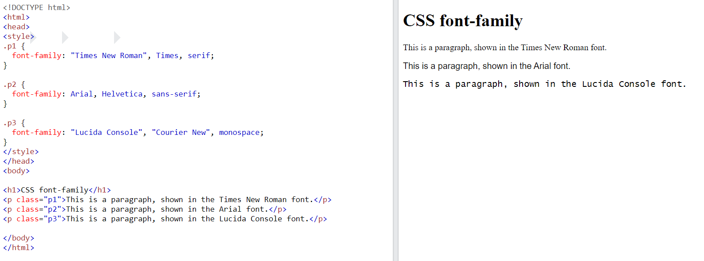
CSS Fonts
Choosing the right font has a huge impact on how the readers experience a website.

Slide 8
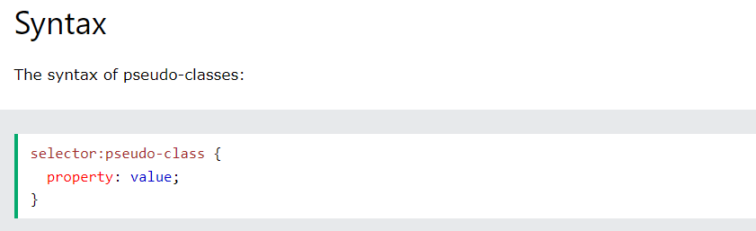
CSS Pseudo-classes
A pseudo-class is used to define a special state of an element.
For example, it can be used to:
Style an element when a user mouses over it
Style visited and unvisited links differently
Style an element when it gets focus

Slide 9
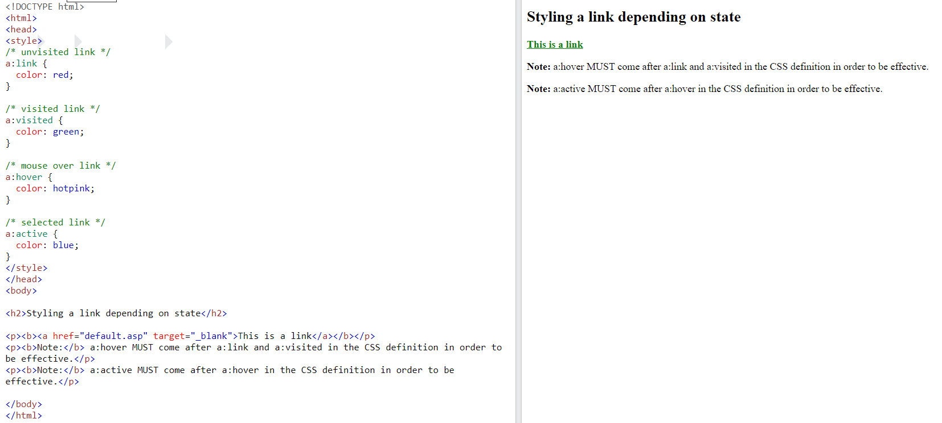
CSS Pseudo-classes
A pseudo-class is used to define a special state of an element.

Slide 10
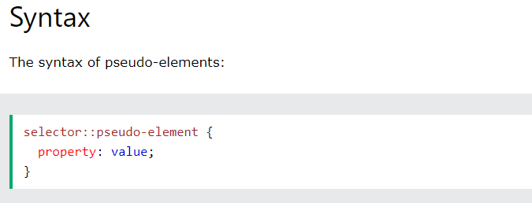
CSS Pseudo-elements
A CSS pseudo-element is used to style specified parts of an element.
For example, it can be used to:
Style the first letter, or line, of an element
Insert content before, or after, the content of an element

Slide 11
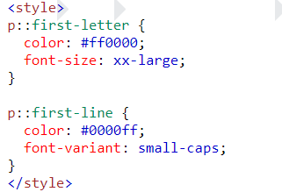
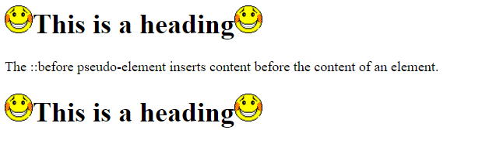
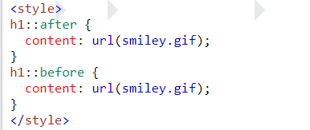
CSS Pseudo-elements
A CSS pseudo-element is used to style specified parts of an element.

Slide 12

CSS Links
With CSS, links can be styled in many different ways.
Styling Links
Links can be styled with any CSS property (e.g. color, font-family, background, etc.).
In addition, links can be styled differently depending on what state they are in.
The four links states are:
a:link - a normal, unvisited link
a:visited - a link the user has visited
a:hover - a link when the user mouses over it
a:active - a link the moment it is clicked

Slide 13
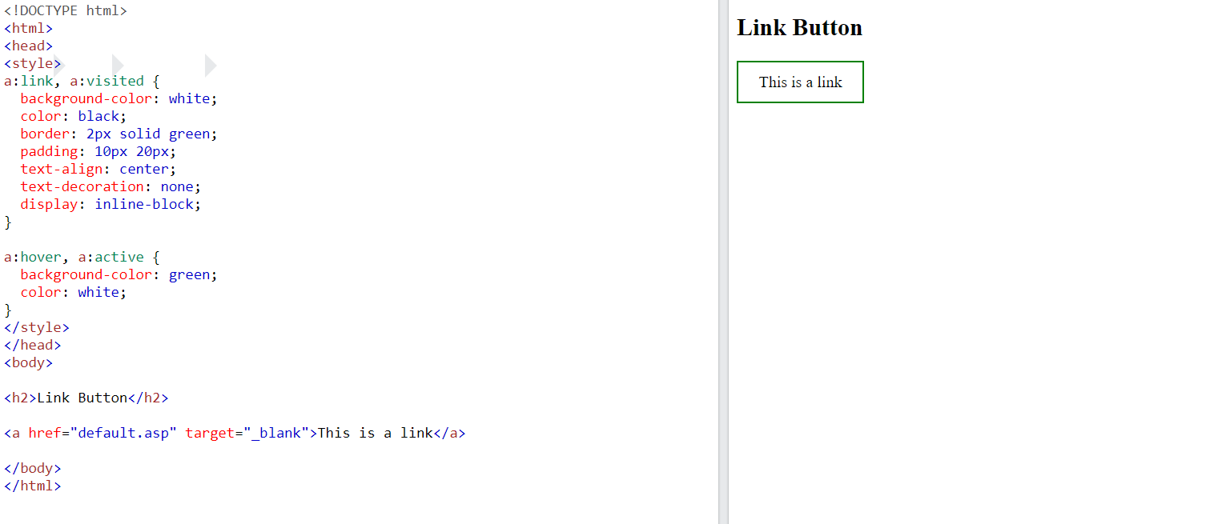

CSS Links
With CSS, links can be styled in many different ways.

Slide 14
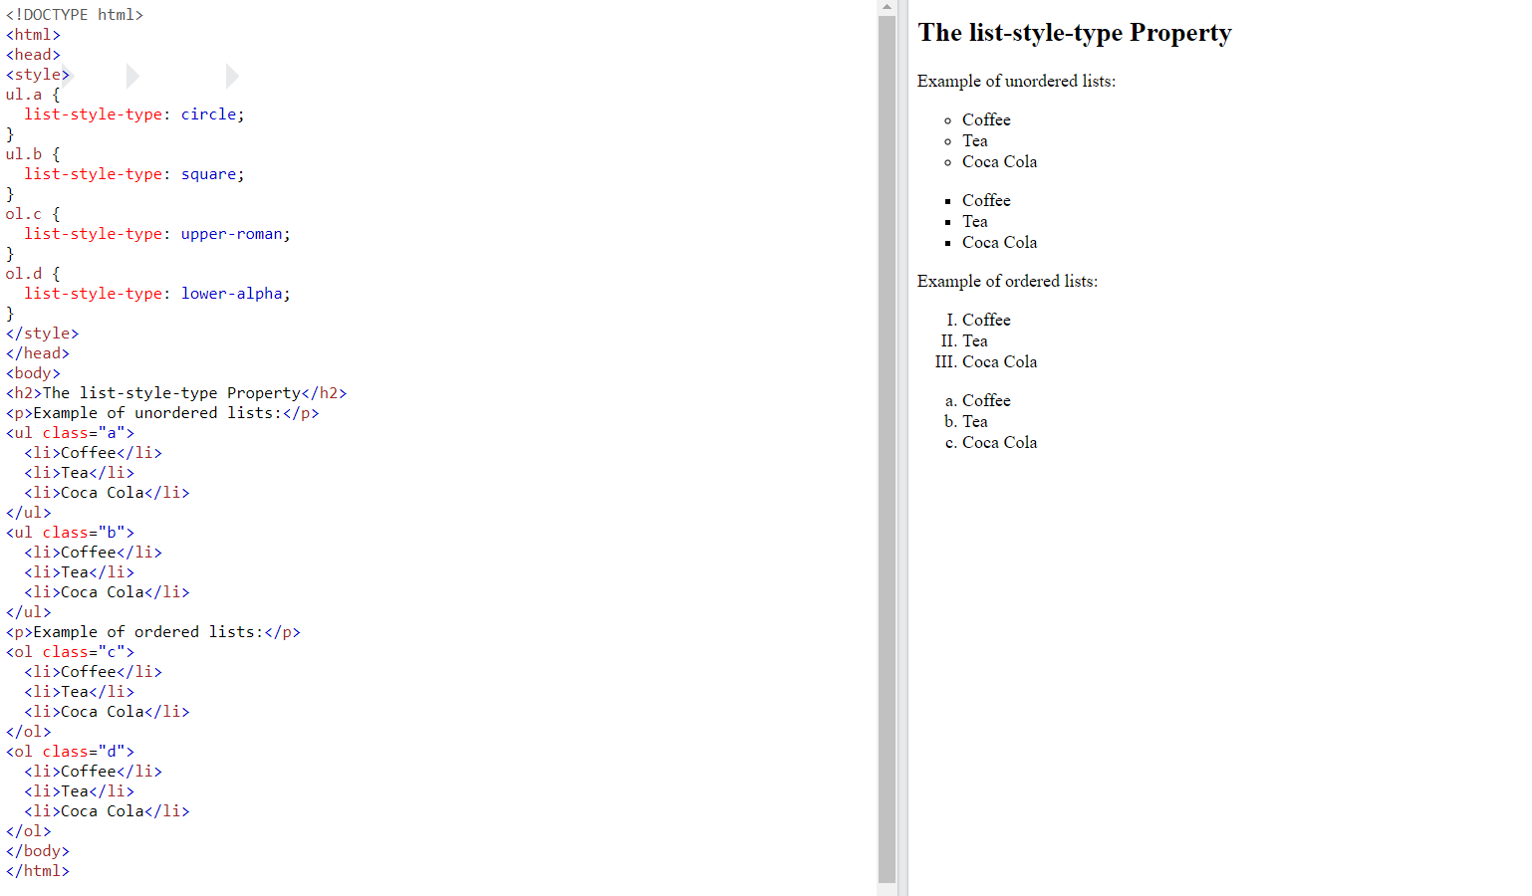
CSS Lists
Different List Item Markers

Slide 15
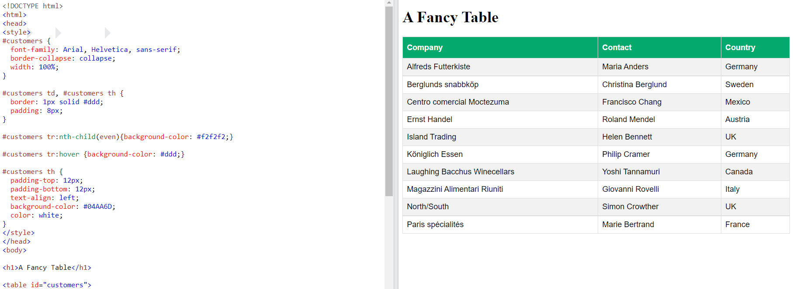
CSS Tables
The look of an HTML table can be greatly improved with CSS:

Slide 16
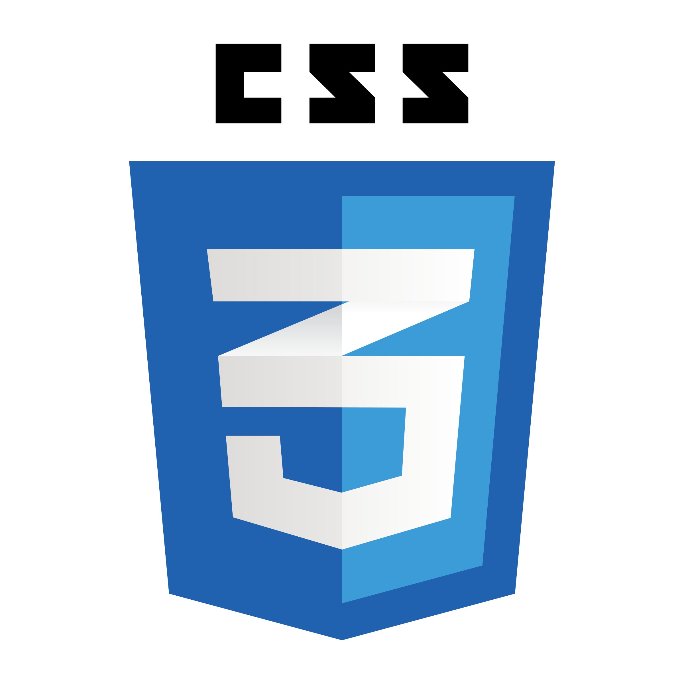
CSS Layout
Display
Position
Float
Overflow

Slide 17
CSS Layout - The display Property
The display property is the most important CSS property for controlling layout.
The display Property
The display property specifies if/how an element is displayed.
Inline Elements
An inline element does not start on a new line and only takes up as much width as necessary.
<span>
<a>
<img>
Display: none;
Block-level Elements
A block-level element always starts on a new line and takes up the full width available (stretches out to the left and right as far as it can).
<div>
<h1> - <h6>
<p>
<form>
<header>
<footer>
<section>
Tryit Editor v3.7 (w3schools.com)

Slide 18
CSS Layout - The position Property
The position property specifies the type of positioning method used for an element
The position Property
There are five different position values:
static
relative
fixed
absolute
Sticky
Elements are then positioned using the top, bottom, left, and right properties. However, these properties will not work unless the position property is set first.

Slide 19
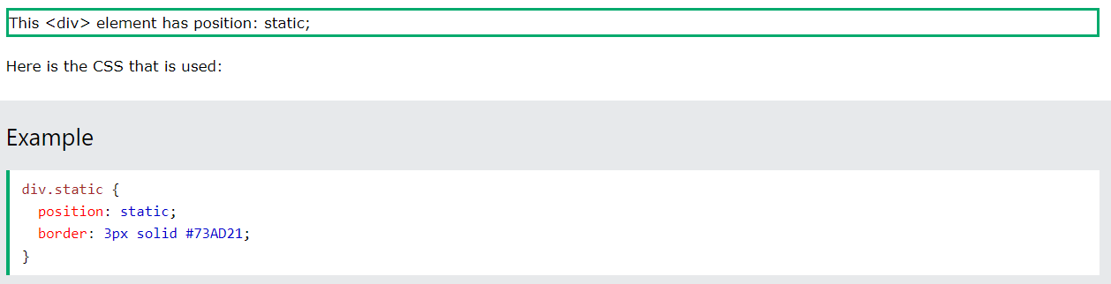
CSS Layout - The position Property
The position property specifies the type of positioning method used for an element
position: static;
HTML elements are positioned static by default.
Static positioned elements are not affected by the top, bottom, left, and right properties.

Slide 20
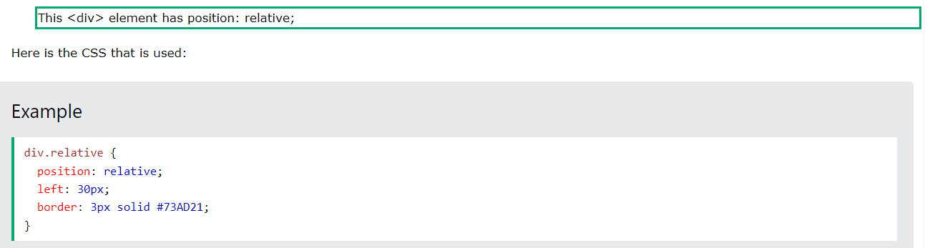
CSS Layout - The position Property
The position property specifies the type of positioning method used for an element
position: relative;
An element with position: relative; is positioned relative to its normal position.
Setting the top, right, bottom, and left properties of a relatively-positioned element will cause it to be adjusted away from its normal position. Other content will not be adjusted to fit into any gap left by the element.

Slide 21
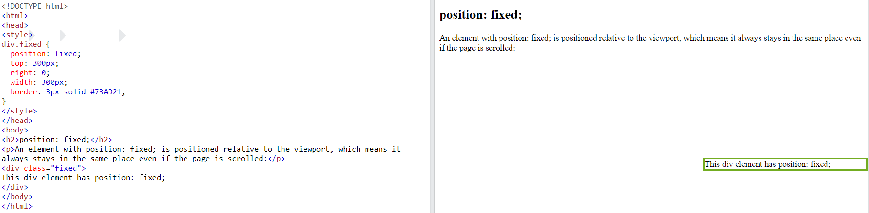
CSS Layout - The position Property
The position property specifies the type of positioning method used for an element
position: fixed;
An element with position: fixed; is positioned relative to the viewport, which means it always stays in the same place even if the page is scrolled. The top, right, bottom, and left properties are used to position the element.

Slide 22
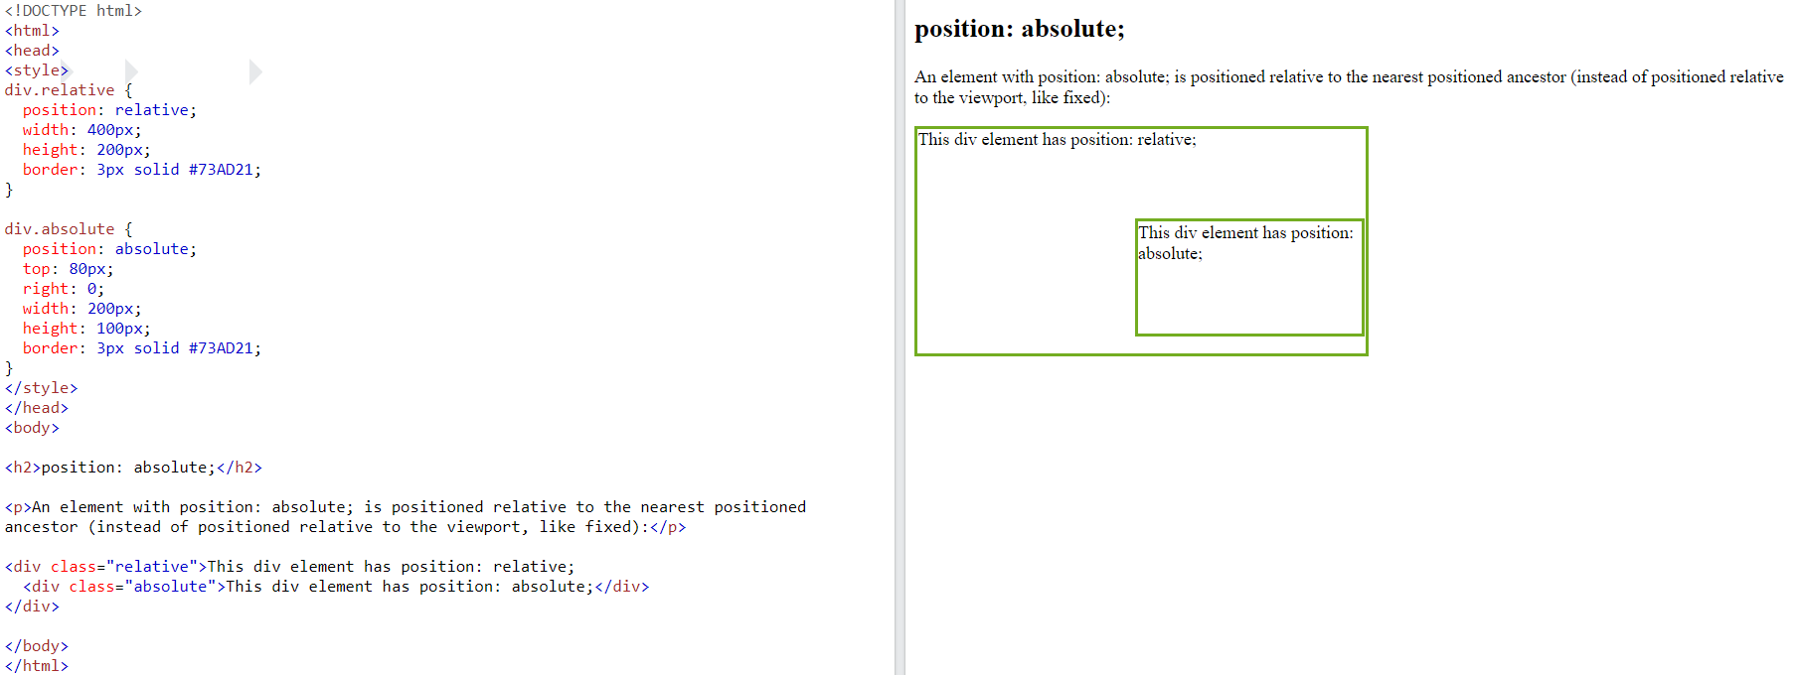
CSS Layout - The position Property
The position property specifies the type of positioning method used for an element
position: absolute;
An element with position: absolute; is positioned relative to the nearest positioned ancestor (instead of positioned relative to the viewport, like fixed).

Slide 23
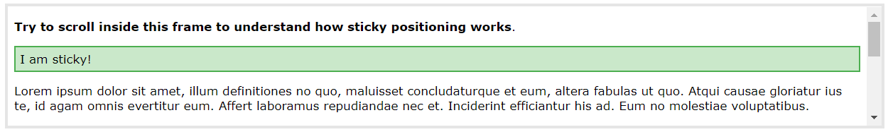
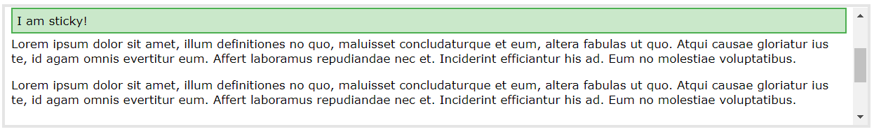
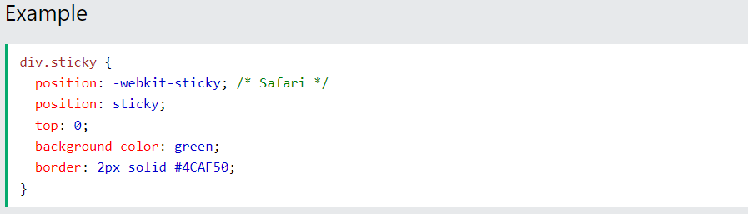
CSS Layout - The position Property
The position property specifies the type of positioning method used for an element
position: sticky;
An element with position: sticky; is positioned based on the user's scroll position.
A sticky element toggles between relative and fixed, depending on the scroll position. It is positioned relative until a given offset position is met in the viewport - then it "sticks" in place (like position:fixed).

Slide 24
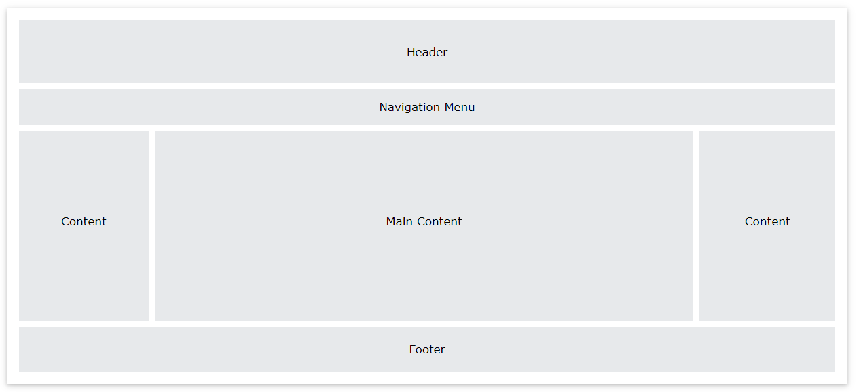
CSS Website Layout
A website is often divided into headers, menus, content and a footer

Slide 25
CSS Layout – float and clear
The CSS float property specifies how an element should float.
The float Property
left - The element floats to the left of its container
right - The element floats to the right of its container
none - The element does not float (will be displayed just where it occurs in the text). This is default
inherit - The element inherits the float value of its parent
The clear Property
When we use the float property, and we want the next element below (not on right or left), we will have to use the clear property.
none - The element is not pushed below left or right floated elements. This is default
left - The element is pushed below left floated elements
right - The element is pushed below right floated elements
both - The element is pushed below both left and right floated elements
inherit - The element inherits the clear value from its parent
Tryit Editor v3.7 (w3schools.com)

Slide 26
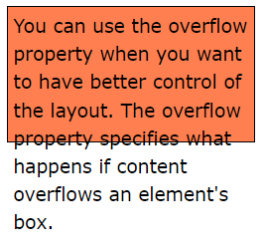
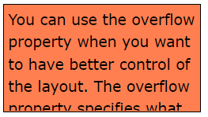
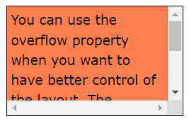
CSS Layout - Overflow
The CSS overflow property controls what happens to content that is too big to fit into an area.
The overflow property has the following values:
visible - Default. The overflow is not clipped. The content renders outside the element's box
hidden - The overflow is clipped, and the rest of the content will be invisible
scroll - The overflow is clipped, and a scrollbar is added to see the rest of the content
auto - Similar to scroll, but it adds scrollbars only when necessary
Visible hidden scroll

Slide 27
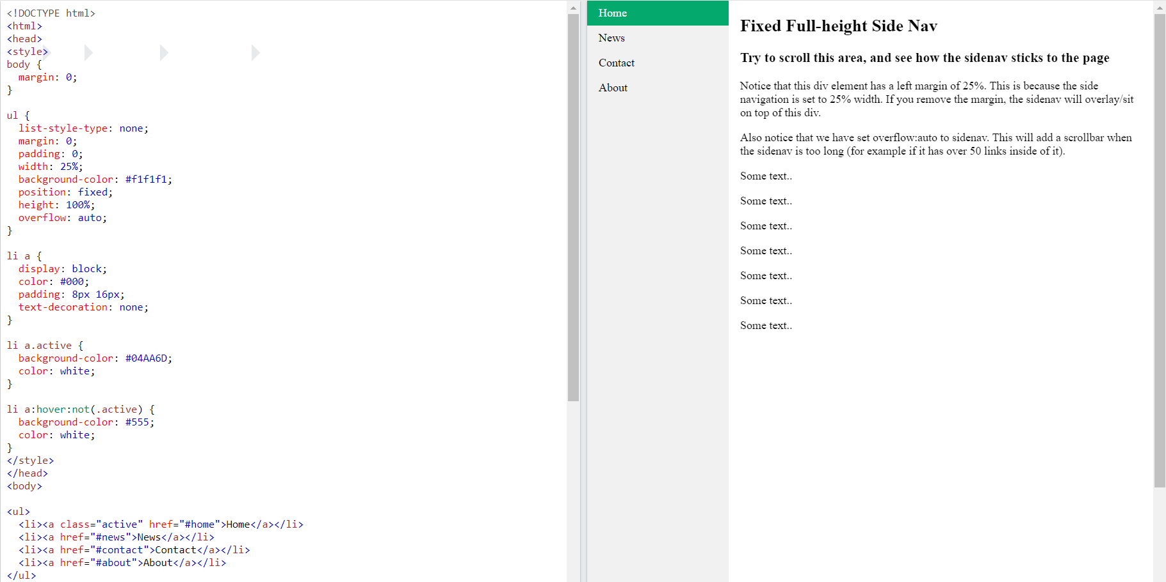
CSS Vertical Navigation Bar

Slide 28
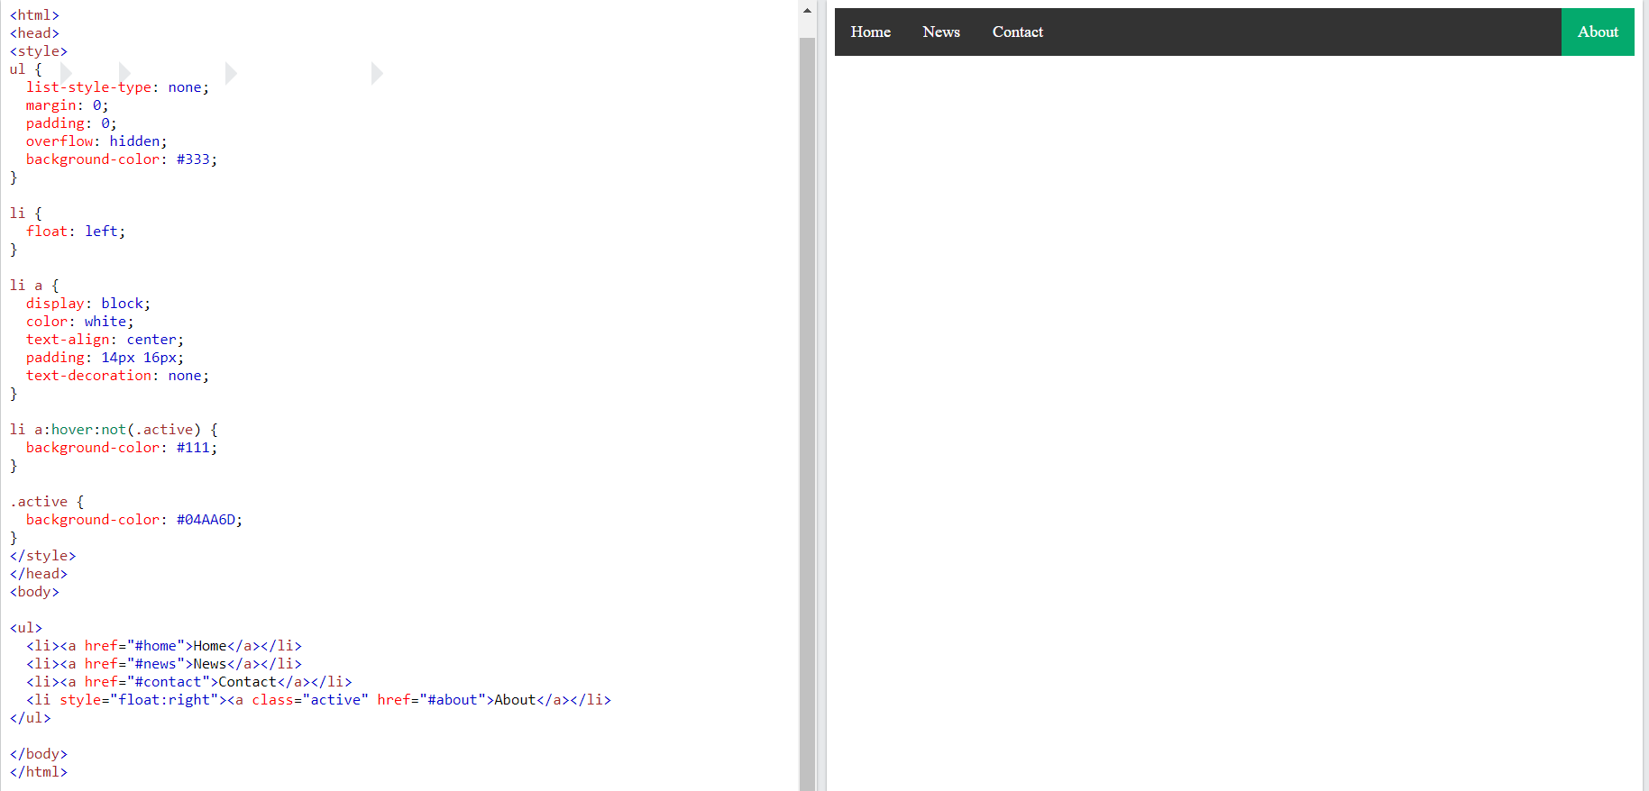
CSS Horizontal Navigation Bar

Slide 29
Summary
Module 04
learning about Fonts
learning about Box Model
learning about font properties with CSS
learning about size
learning about weight
learning about text alignment

